Slide 1
Central Data Exchange Demo
Storyboard

Slide 2
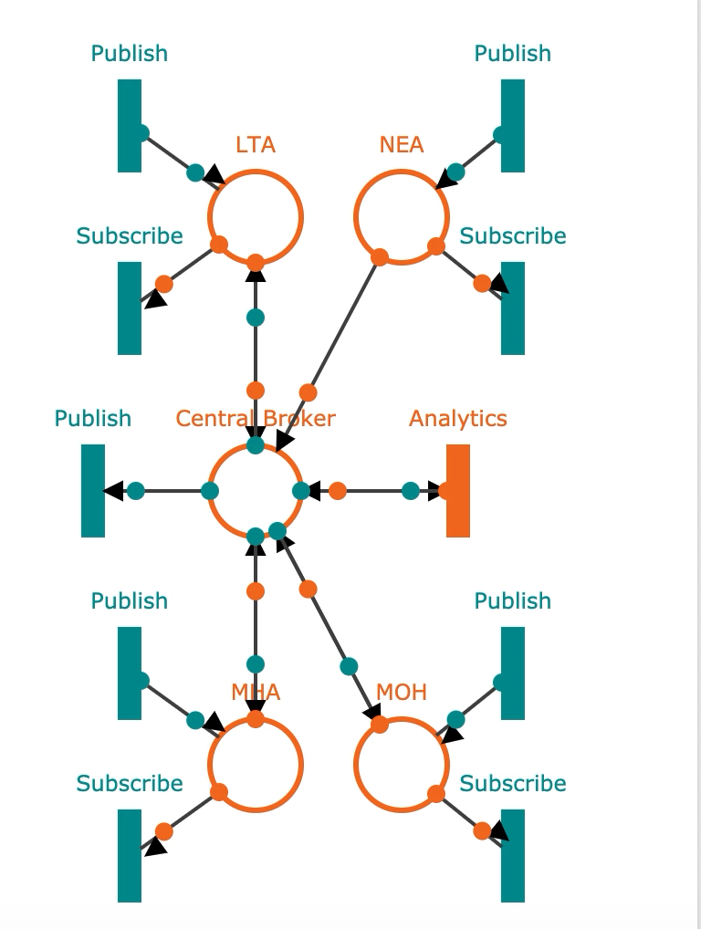
Example Broker Set-up

Slide 3
Overall Site Diagram
Login Page
Homepage
Register
Admin
Analytics & Mapping
Available
Topics
Analytics & Mapping
Dataflow
Graph
Published
Topics
Message
Logs
Register
Agency
Notes:
Polyglot, Open API Ecosystem

Slide 4
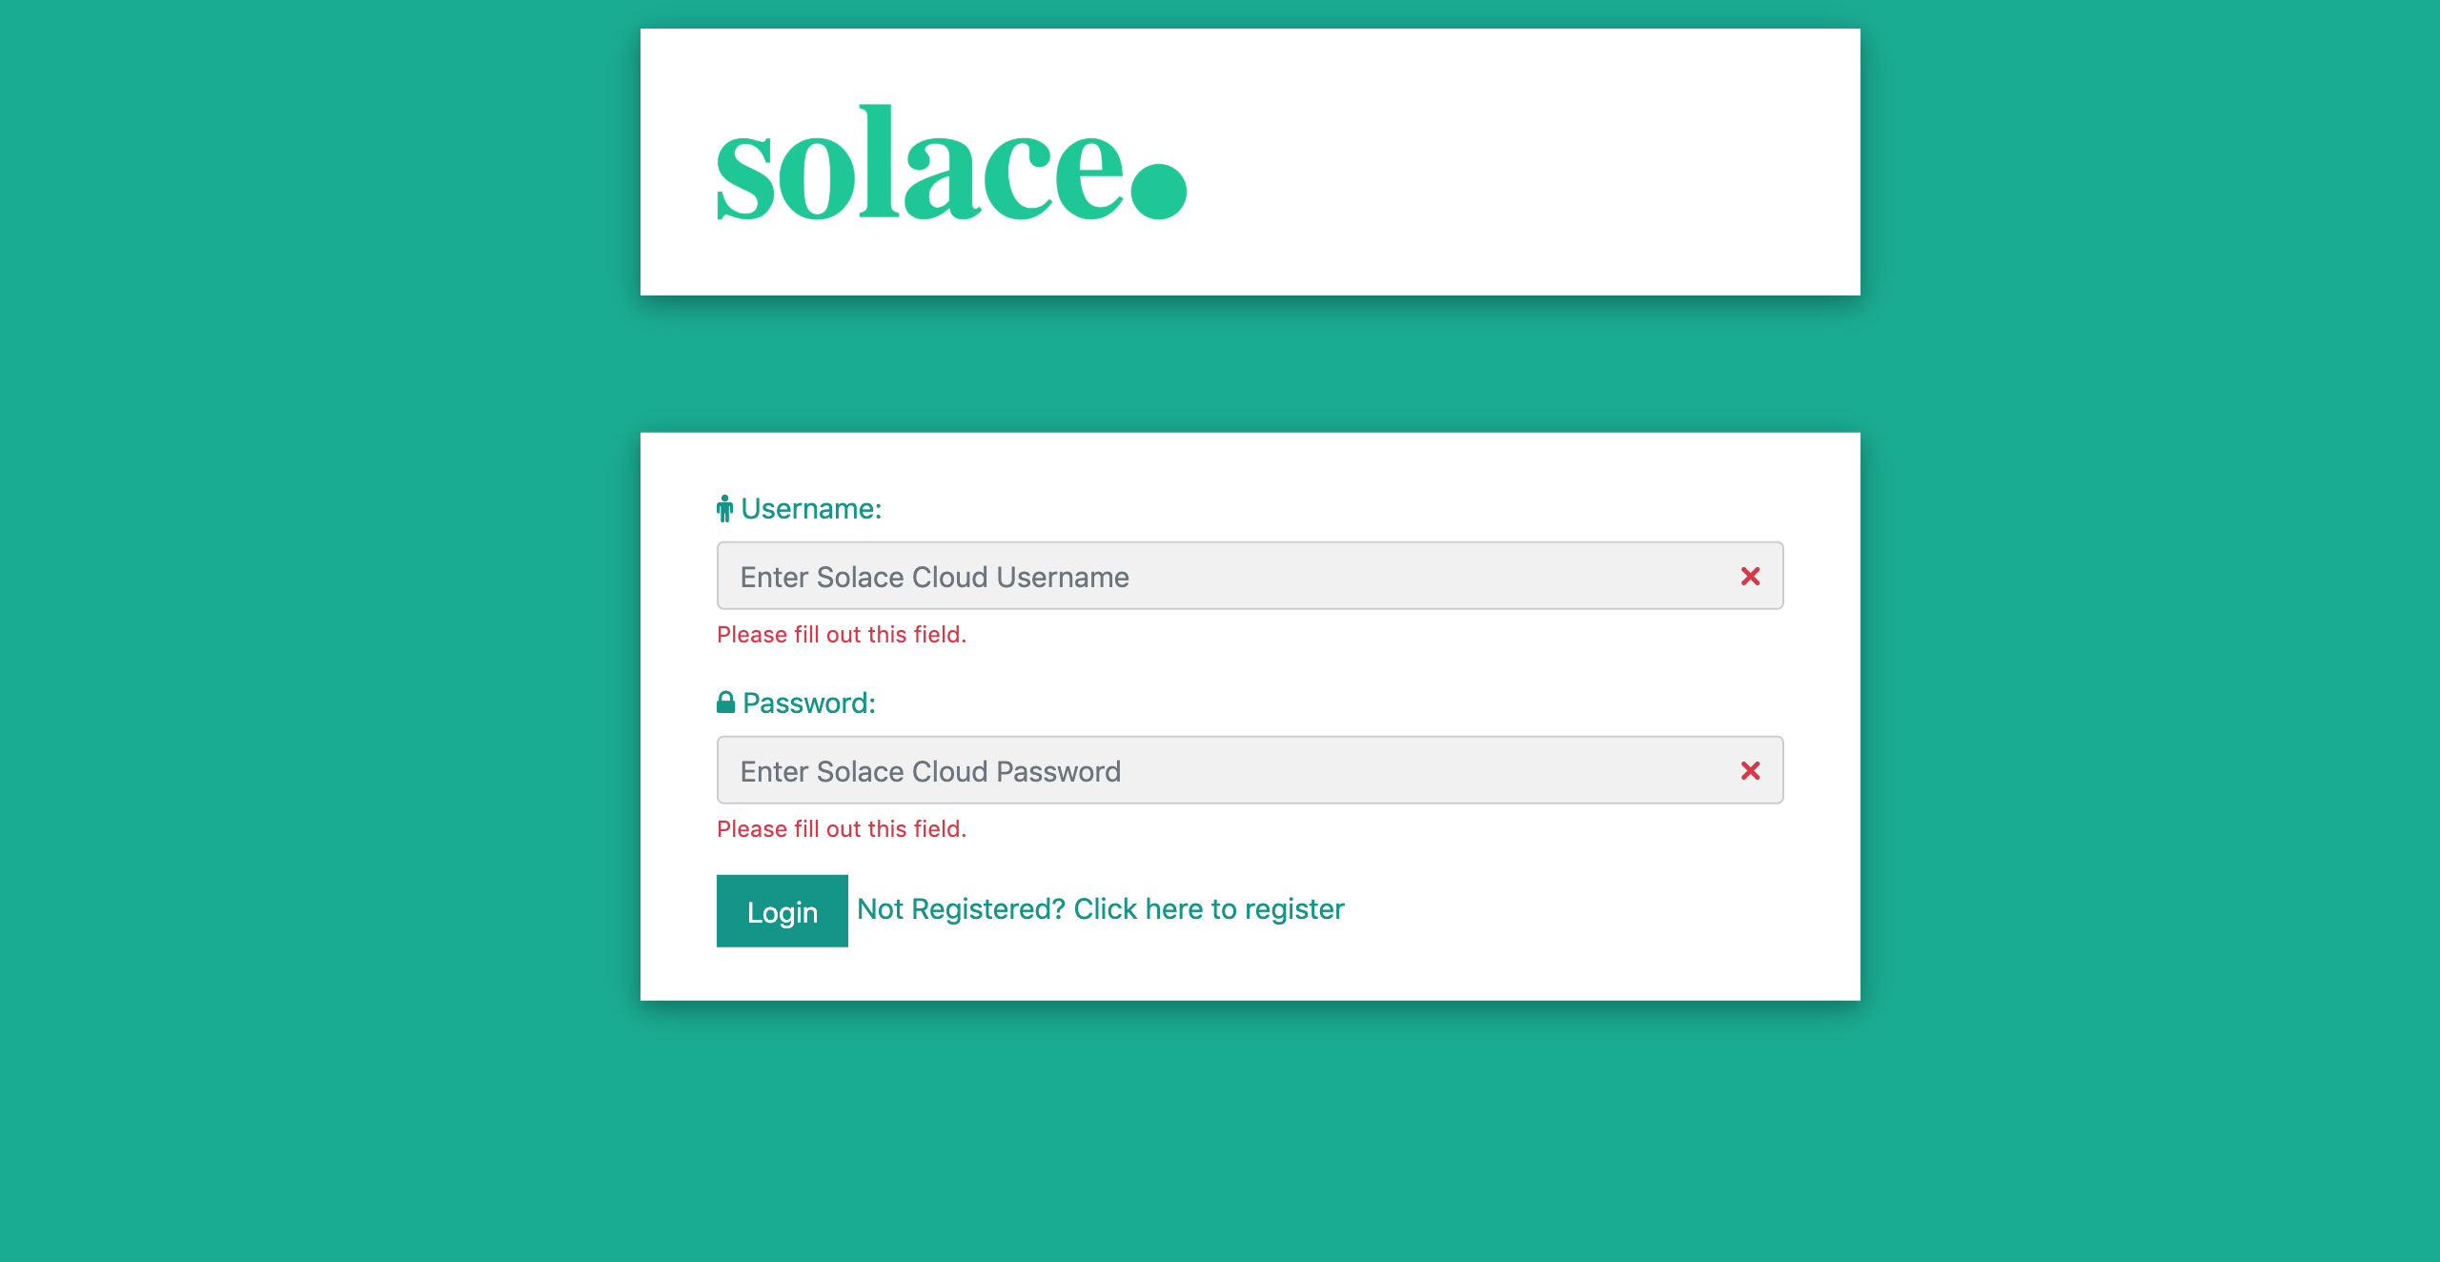
Log-in Page
First page to start from when running the demo
Page to access the central broker and view topics available to be used
New agencies can access the registration page from here

Slide 5
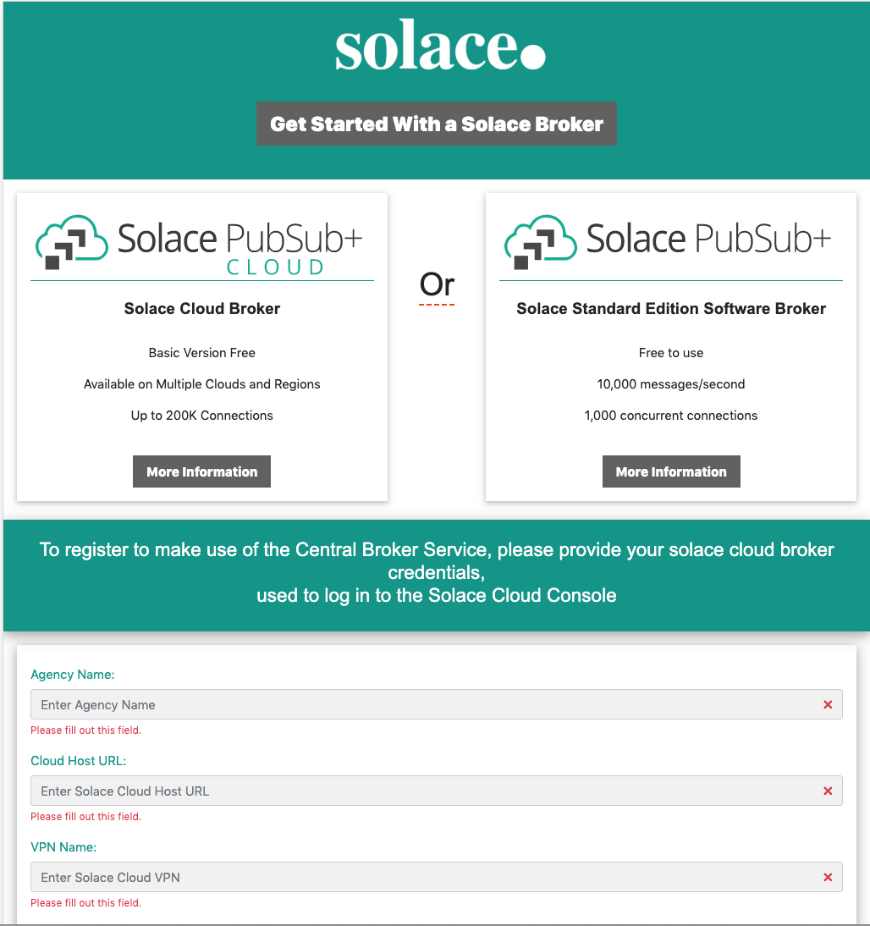
Registration Page
Information on broker available here
New Agencies can provide their solace broker details to request to be connected to the central broker
Solace broker details will be used by the central broker administrator to establish a new bridge

Slide 6
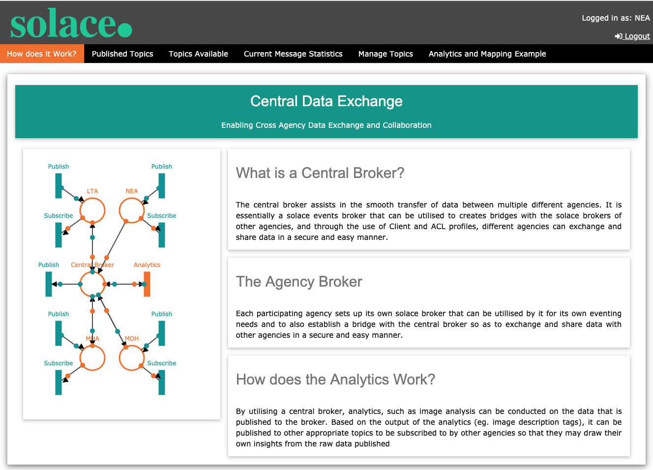
Home Page
After logging on using a username registered on the ACL this the page that users will be led to
Provides brief description about the exchange and its features
Other tabs can be accessed from the navbar

Slide 7
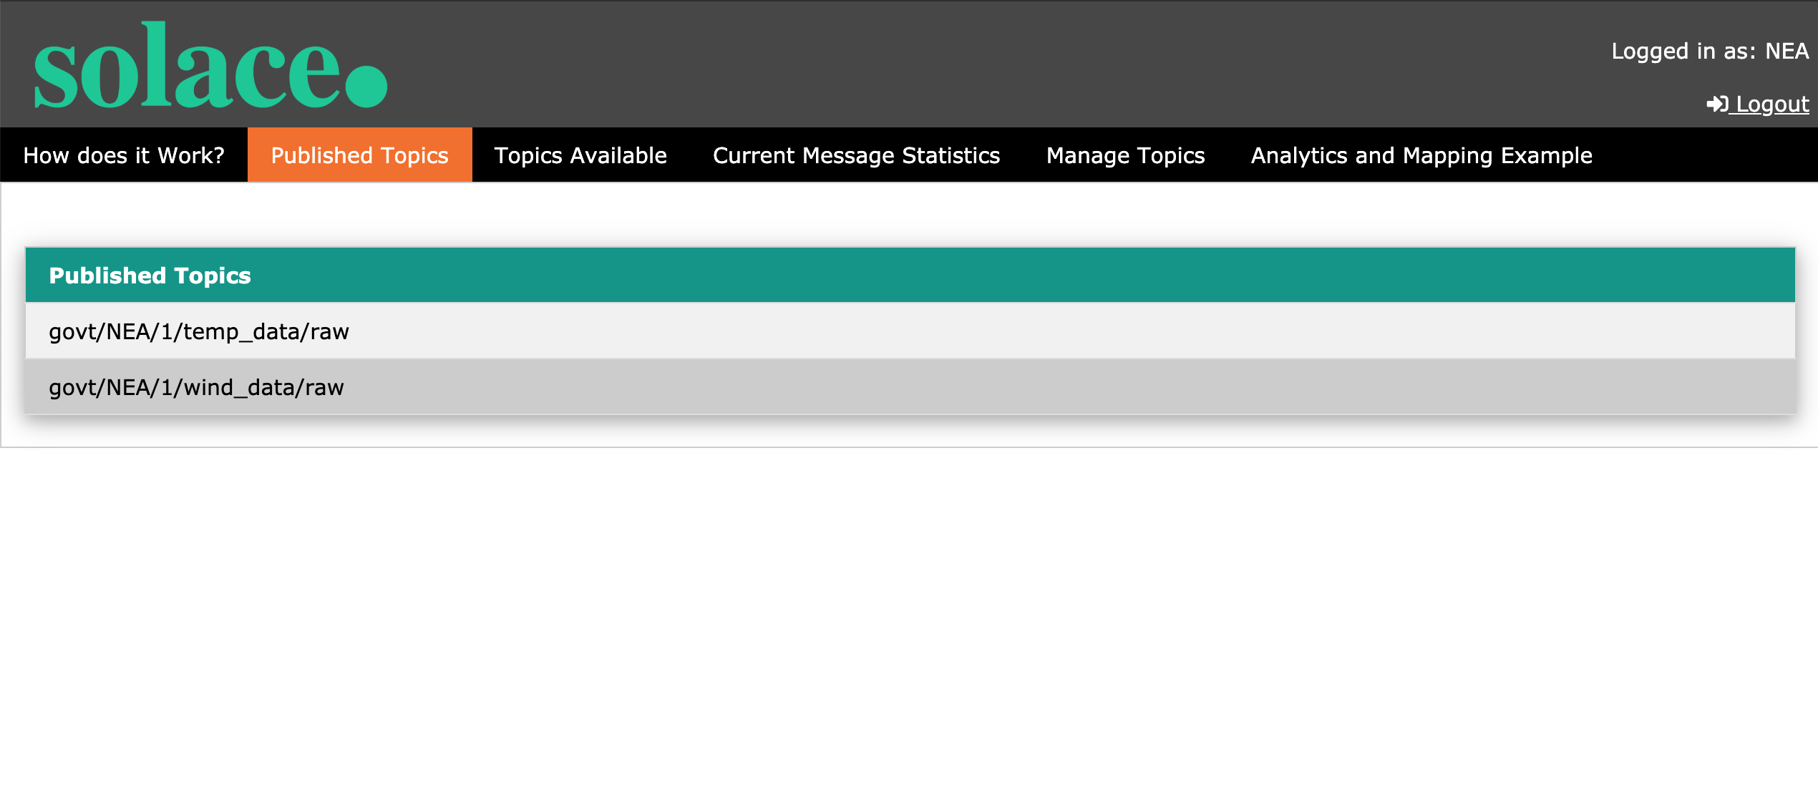
Home Page – Published Topic
Utilises an Access Control List (ACL) to populate all Topics that the agency is publishing to the central broker
Establishes a bridge with central broker to publish its data to other potentially interested broker

Slide 8
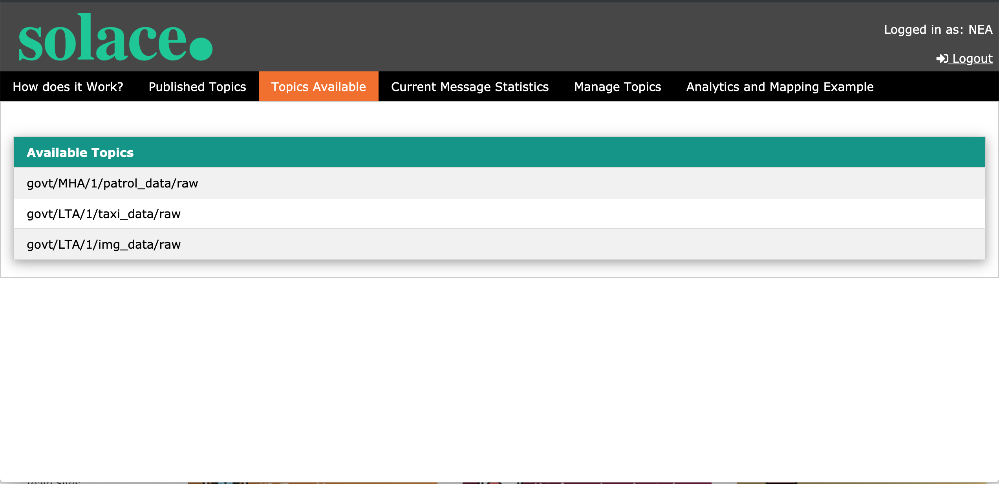
Home Page – Topics Available
Utilises an Access Control List (ACL) to populate all Topics that are available for the agency to subscribe to via the central broker
Through establishment of a bridge with central broker, agency can subscribe to topics of their choice

Slide 9
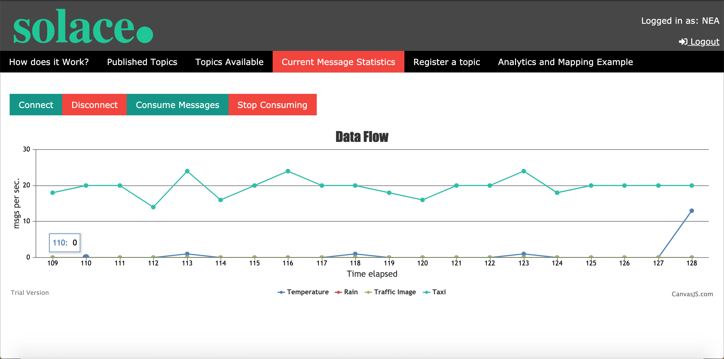
Home Page – Current Message Statistics
Provides an overall view of the message flow rate from various topics that the agency is subscribed or publishing to
*Also acts as central analytics in background, processing all messages that published on central broker (for map analytics)

Slide 10
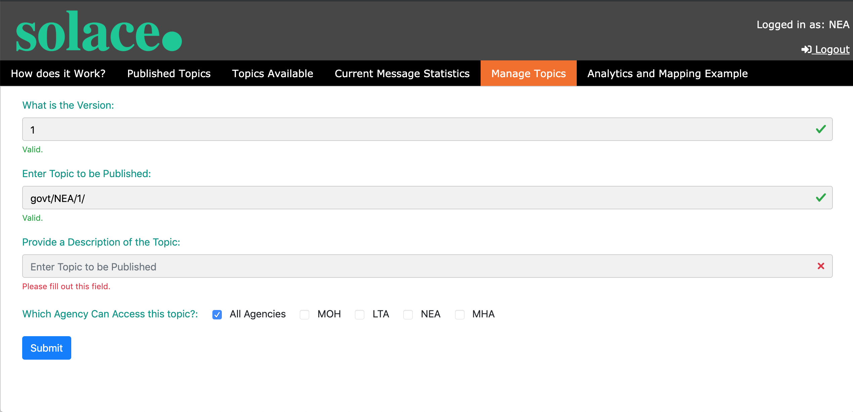
Home Page – Topic Registration
User can register new topics that they wish to share on the central broker
Access control as to which agencies can access these topics, can also be indicated
Once approved, inserted topic will be available in Access Control

Slide 11
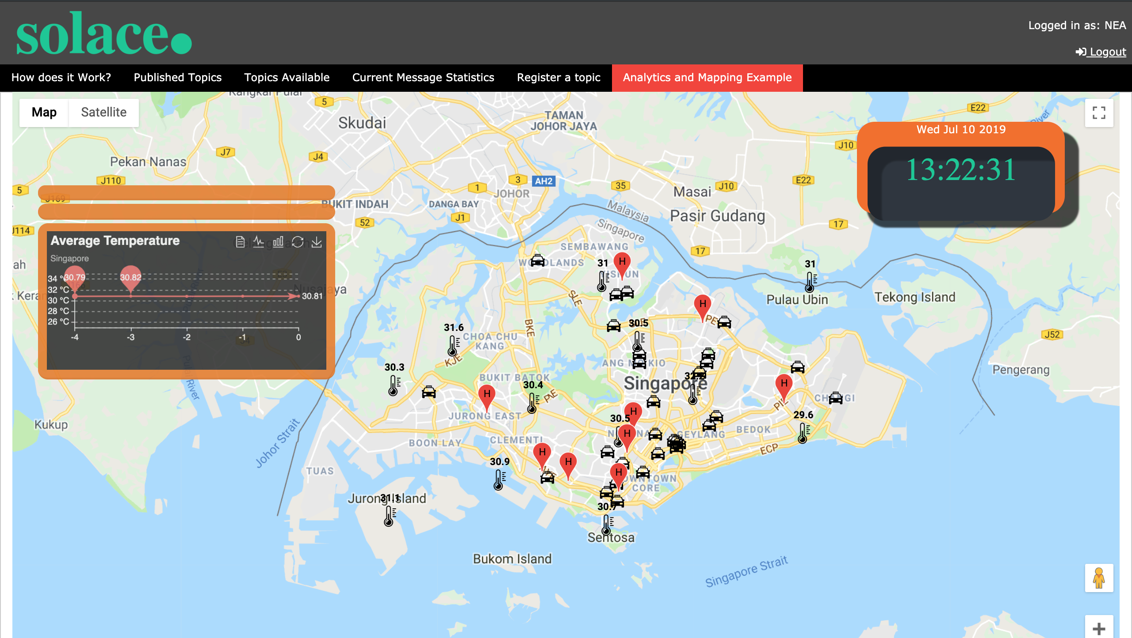
Home Page – Analytics & Mapping Example
Provides an example of various data streams consumed from different agencies and geospatially maps it
Raw data is also processed through a central analytics and based on the output, is further republishes to other subtopics.

Slide 12
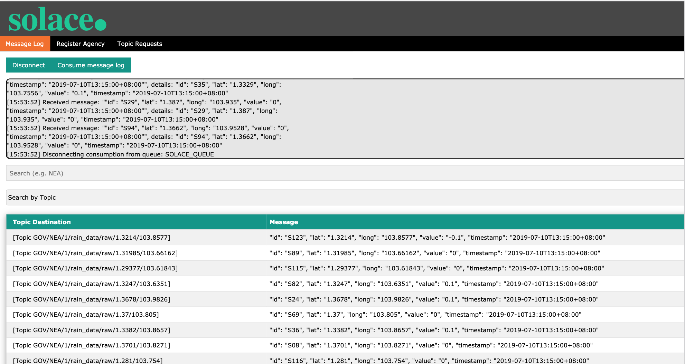
Admin Page - Message Log
This view is accessed by login in via the login console using username: admin password: pass
User can view a complete log of all messages published and further search based on key words or individuals

Slide 13
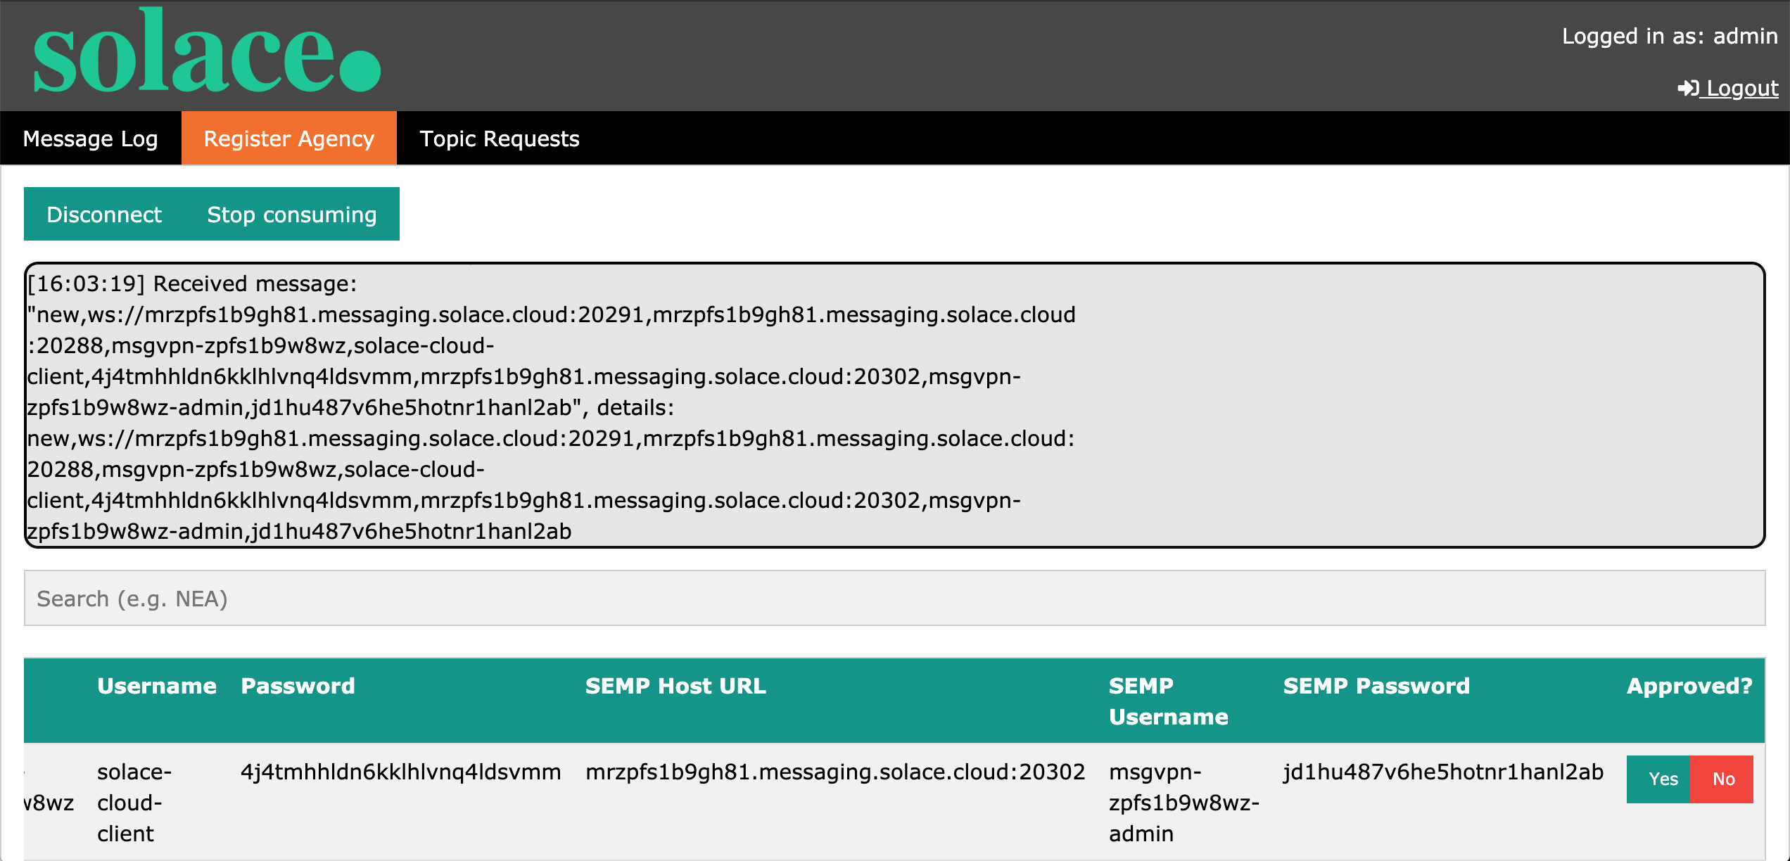
Admin Page - Register Agency
This view is accessed by login in via the login console using username: admin password: pass
User can view the registration information provided by the agencies and further utilize it to create a bridge between the agencies broker and the central broker
Clicking yes will trigger the SEMP call and create a bridge from the central broker to the agency broker using the information provided

Slide 14
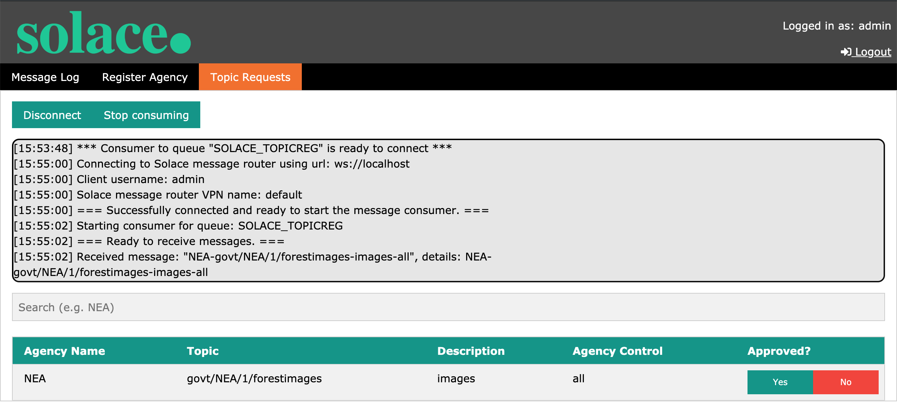
Admin Page - Register Topic
This view is accessed by login in via the login console using username: admin password: pass
Administrator can view the Topic information provided by the agencies and subsequently approve or deny the agency to start publishing to the topic on the central broker
Upon clicking yes a SEMP call is triggered to create the topic in the relevant ACLs

Slide 15
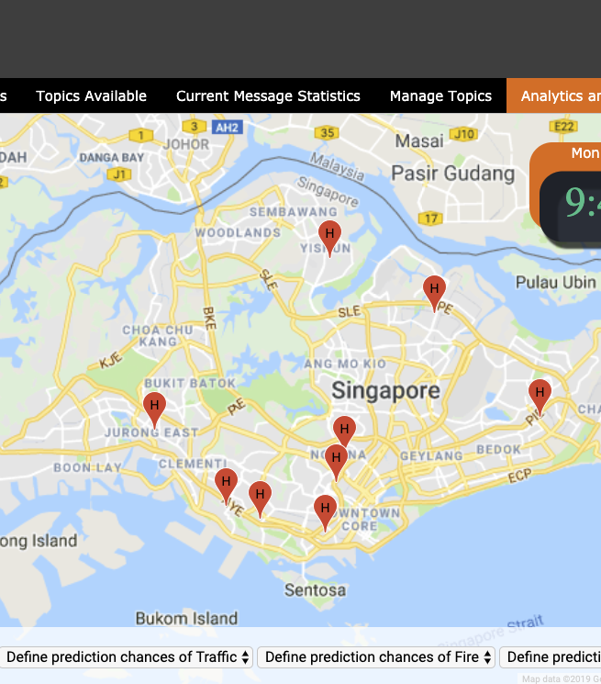
Map Demonstration Analytics
We provided a demonstration for the consumer to see how the data comes together through the google maps demo.

Slide 16
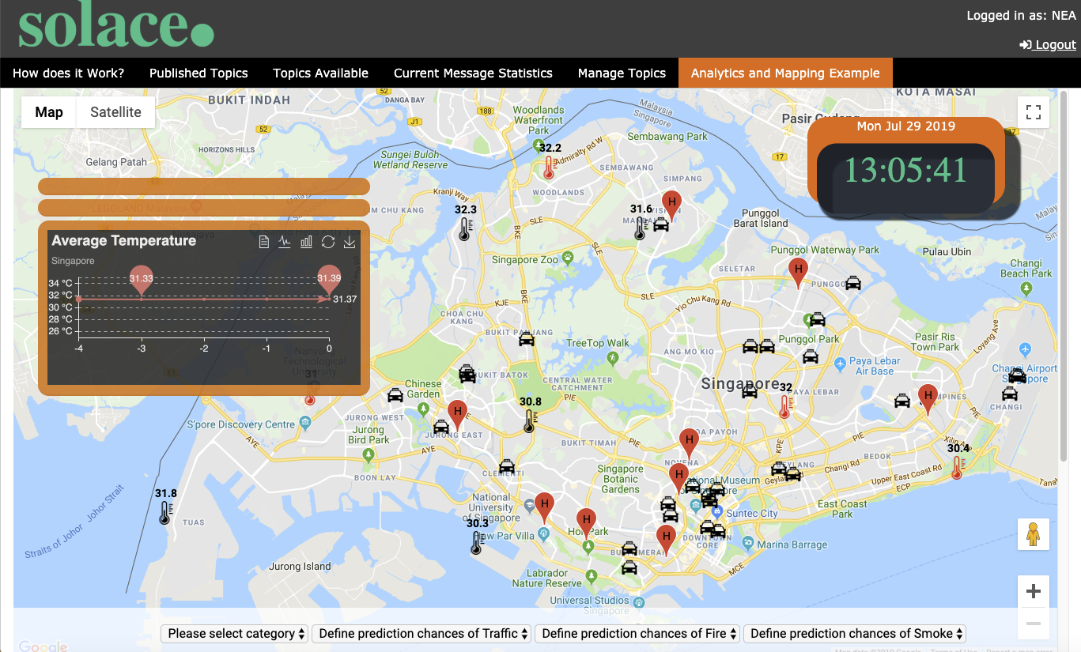
Demonstration with Map Analytics
Temperature Data from the NEA agency. (GOV/NEA/1/temp_data/raw/[lat]/[long])
Rain Data from the NEA agency. (GOV/NEA/1/rain_data/raw/[lat]/[long])
Traffic Patrol from the LTA agency. (GOV/LTA/1/taxi_data/raw)
Traffic Images from the LTA agency. (GOV/LTA/1/img_data/raw)
Hospital Location from the MHA agency.

Slide 17
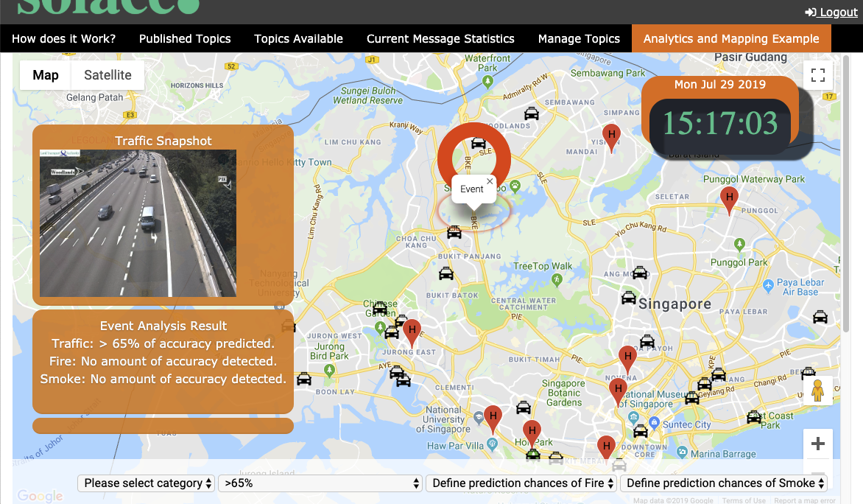
Event-Driven Analytics
Live-Image Capturing of the traffic images of the express way in Singapore. Using Microsoft Computer Vision Analytics, the system will be able to scan and detect any traffic anomaly on the road and provide instant feedback to any interested parties. The analytic is able to detect objects such as fire, smoke, or heavy traffic in cases of incident.

Slide 18
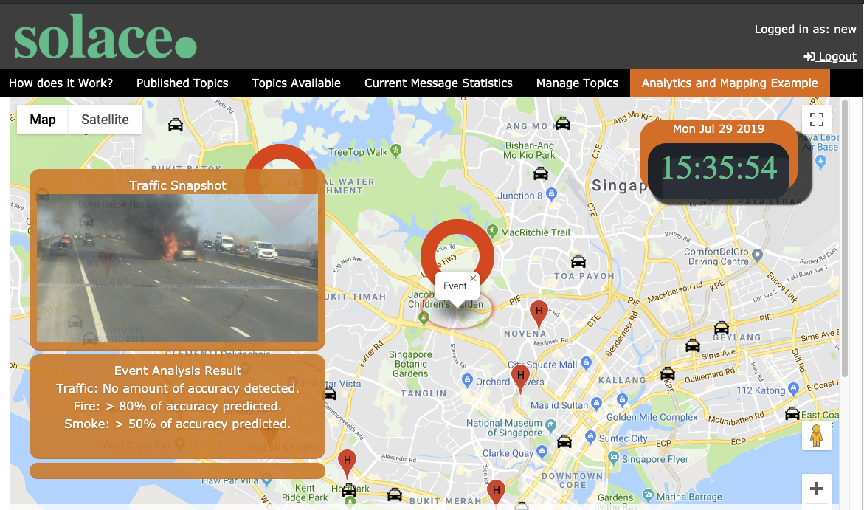
Image of Interest
Interested parties can subscribe to their respective events of interest to maximize their efficiency. For example, traffic patrols are able to subscribe to events that has heavy traffic; paramedics are able to subscribe to events that involves any incident on the traffic.

Slide 19
Topic Subscription
GOV/LTA/1/img_data/raw/[lat]/[long]/{traffic}/{fire}/{smoke}
The lat and long is based on traffic image sensor location.
Initially, GOV/LTA/1/img_data/raw is being subscribed by the central analytics to do some processing.
{traffic}/{fire}/{smoke} is based on the prediction result by central analytics using Microsoft computer vision. It represents the accuracy of prediction detected for each of the object.
Condition for traffic, fire and smoke object:
{
“/0”: Prediction between 0% ~ 29% accuracy,
”/11": Prediction between 30% ~ 49% accuracy,
"/111": Prediction between 50% ~ 64% accuracy,
"/1111": Prediction between 65% ~ 79% accuracy,
"/11111": Prediction between 80% ~ 100% accuracy
}
Etc. If subscriber is looking for only traffic with more than 50% accuracy: “/11*/0/0”.

Slide 20

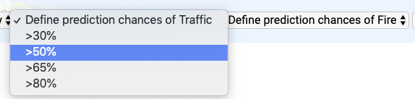
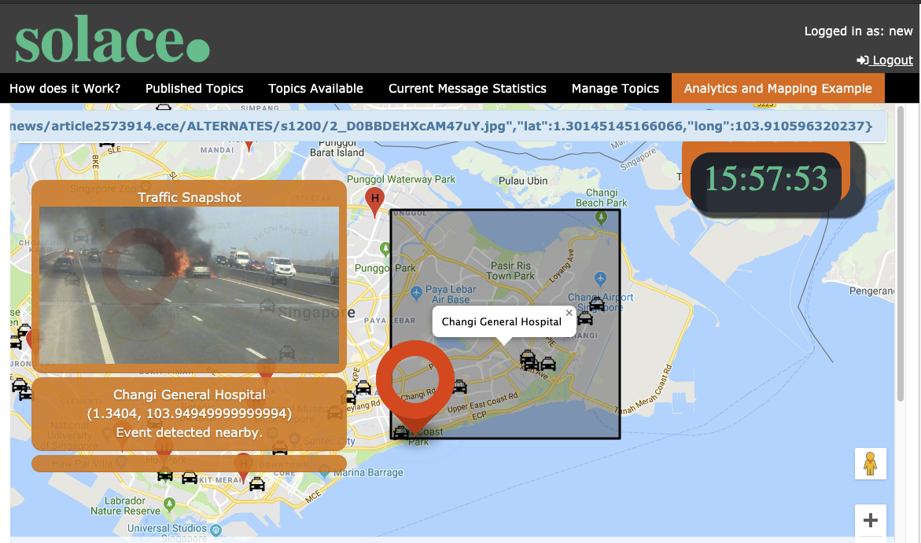
Subscribing Within Proximity
Entities such as Patrol or Medical Outpost are also able to subscribe to its remote location and detecting nearby events. They will be notified for its filtered events.
Entities can subscribe with specified threshold (Heavier traffic etc.) to customize to their own criteria.

Slide 21
Topic Subscription
GOV/LTA/1/img_data/raw/[lat]/[long]/{traffic}/{fire}/{smoke}
The lat and long is based on facility location.
Current location eg: { lat : 1.254, long: 1.342 }. If a subscriber looks for interested event within its location, subscription: 1.2*/1.3*/0/0/0 etc.
Subscribers are able to make their searching scope smaller by inputting specific decimals such as : /1.25*/1.34* etc.

Slide 22
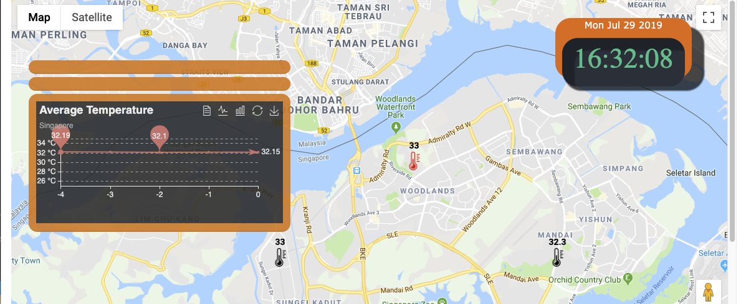
Event-Driven Temperature Readings
This application attempts to capture temperature readings throughout the districts in Singapore, whilst capturing any areas that have experienced a drastic change in temperature.
If the change is higher than the specified threshold within an hour, subscribers are able to receive the event in real-time.

Slide 23
Topic Subscription
GOV/NEA/1/temp_data/change/[lat]/[long]
The lat and long is based on temperature sensor location.
Initially, GOV/NEA/1/temp_data/raw/[lat]/[long] is being subscribed by the central analytics to do some processing.
The analytics will then process the data for every sensors. It will compare the range of the readings of its past hour to find for each sensors that have exceed a certain threshold. (eg. 0.5 degree change for every hour)
If a sensor reading exceeds the threshold, the analytics will publish the data to topic: GOV/NEA/1/temp_data/change/[lat]/[long].

Slide 24
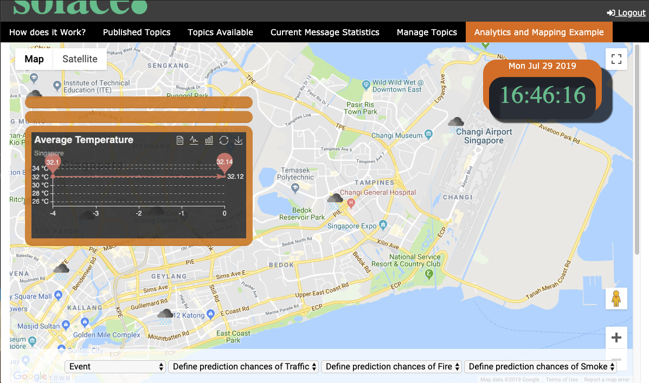

Event-based Rain Sensors
Subscribers are able to subscribe to areas that sensors detection of rain wherever it starts and stops.

Slide 25
Topic Subscription
GOV/NEA/1/rain_data/start/[lat]/[long] & GOV/NEA/1/rain_data/stop/[lat]/[long]
The lat and long is based on rain sensor location.
Initially, GOV/NEA/1/rain_data/raw/[lat]/[long] is being subscribed by the central analytics to do some processing.
The analytics will attempt to detect the change of each sensor if it changes 0 or 1 vice versa.
It will republish the data to either of the topic subscription based on value { 0: “Rain stops”, 1: “Rain starts” }.

Slide 26
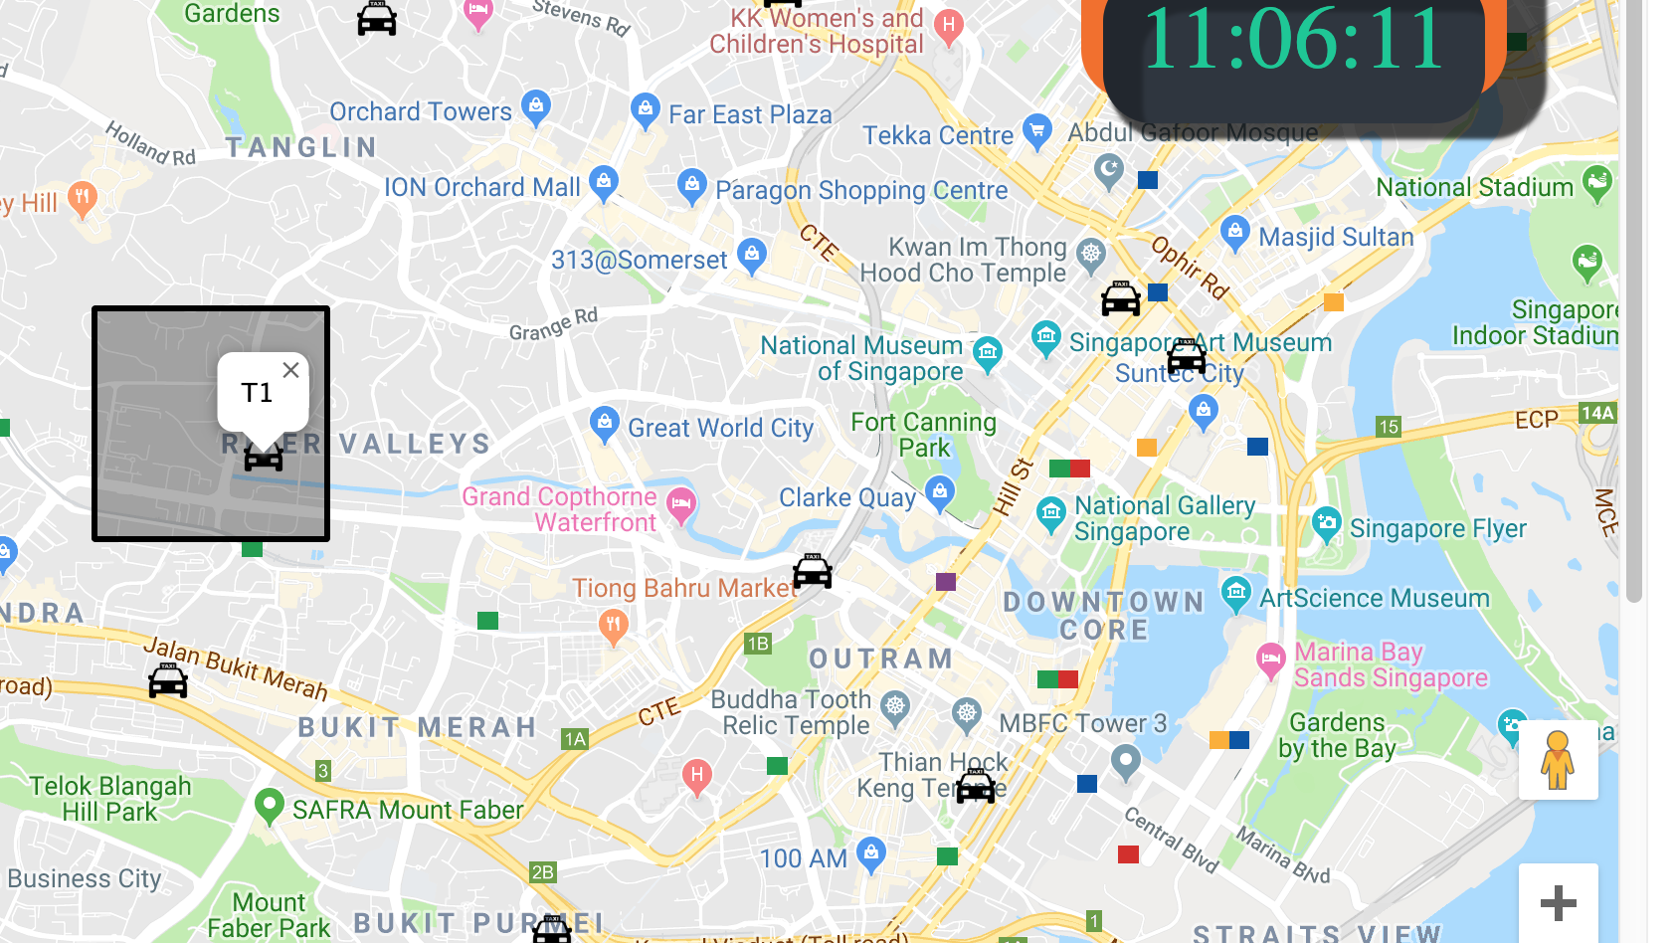
Location Tracking for Patrols
Besides tracking patrol unit on their location in real-time, each patrol unit is able to subscribe to its remote location for any nearby traffic events that are happening around the map. It will be immediately informed of the event depending on the location they are subscribed to. This is similar to “Subscribing within Proximity” as mentioned.

Slide 27
Topic Subscription
GOV/LTA/1/img_data/raw/[lat]/[long]/{traffic}/{fire}/{smoke} for remote event subscription
The lat and long is based on patrol unit location.
Current location eg: { lat : 1.254, long: 1.342 }. If a subscriber looks for interested event within its location, subscription: 1.2*/1.3*/0/0/0 etc.
Subscribers are able to make their searching scope smaller by inputting specific decimals such as : /1.25*/1.34* etc.

Slide 28
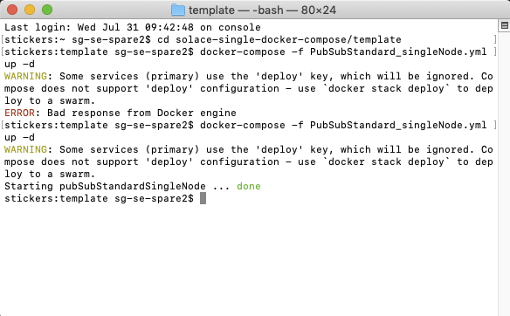
Data Source for Map Analytics 1. Setting Up
Firstly, docker for Solace has to be installed and running in order to set up our localhost (aka Central Broker) in order for the Demonstration to work.
Through Terminal, navigate to the folder {cd /solace-single-docker-compose/template} and execute {docker-compose –f PubSubStandard_singleNode.yml up -d}. Ensure the Node is successfully deployed.

Slide 29
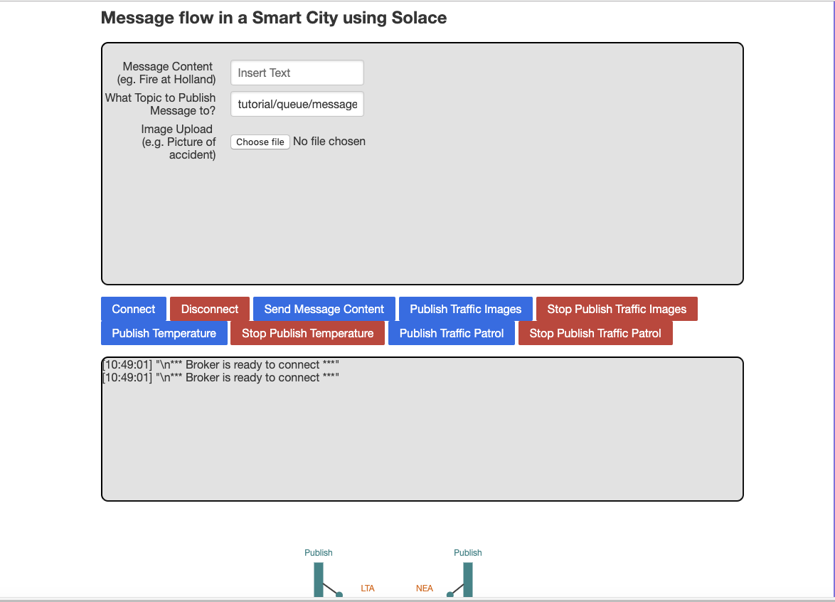
Data Source for Map Analytics (Console and Setting Up Demonstration)
Access to /index.html to grant console access and simulate the publishing of data
This console is mainly used for simulating the publishing of data from LTA and NEA, as well as testing of the data flow within.
In this simulation, the Connect and Disconnect button is meant for both agency NEA and LTA to connect simultaneously.
Once connected, NEA and LTA can began to publish their raw data.

Slide 30
Setting Up Demonstration for Map Analytics (2. Console)
All data sources are taken from data.gov.sg via API calls. API calls are executed for each publishing.
Both NEA and LTA agencies must be granted access on the localhost that is deployed on the docker. ACL must be properly configured to allow the respective agencies to publish its data to the central broker (localhost). Currently, NEA and LTA is configured under the Client Username “NEA” and “anotherlta”.
Publish Traffic Image attempts to publish these images from LTA. It is published as GOV/LTA/1/img_data/raw on the simulation.

Slide 31
Setting Up Demonstration for Map Analytics (2. Console)
Publish Temperature includes both the publishing of temperature and rain data from the NEA. It is operated under real-time API from data.gov.sg.
Publish Traffic Patrol is the publishing of the remote location of each patrol from LTA. The actual data comes from remote location of cab in Singapore to simulate the movement in the demonstration.
These publish topics must be allowed on localhost ACL in order to receive data on the central broker.

Slide 32
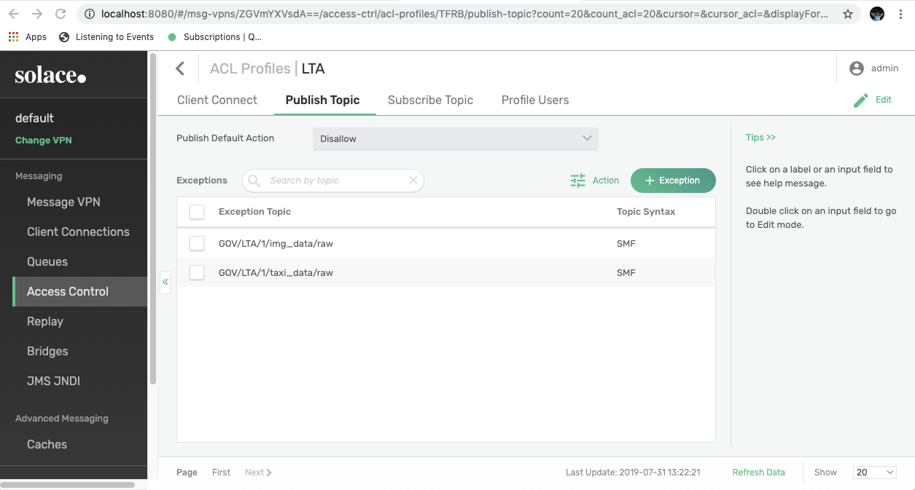
Data Source for Map Analytics (3. Access Control)
To MANUALLY access or add subscription list for each of the agencies, console administration for the central broker can be login via localhost:8080. The settings can be changed via ACL Profiles.

Slide 33

Data Source for Map Analytics (4. Central Analytics Processing)
The central analytics is processed manually as it subscribes to raw data and republishes as new topics.
** Although the data flow graph shows purely the message statistics flow, it also acts as central analytics to process data, by clicking “Consume Messages” on the background.

Slide 34
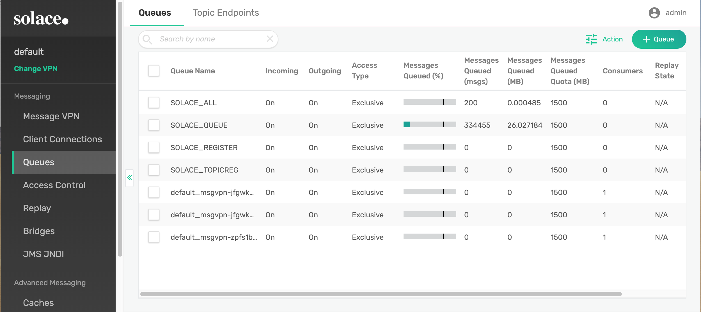
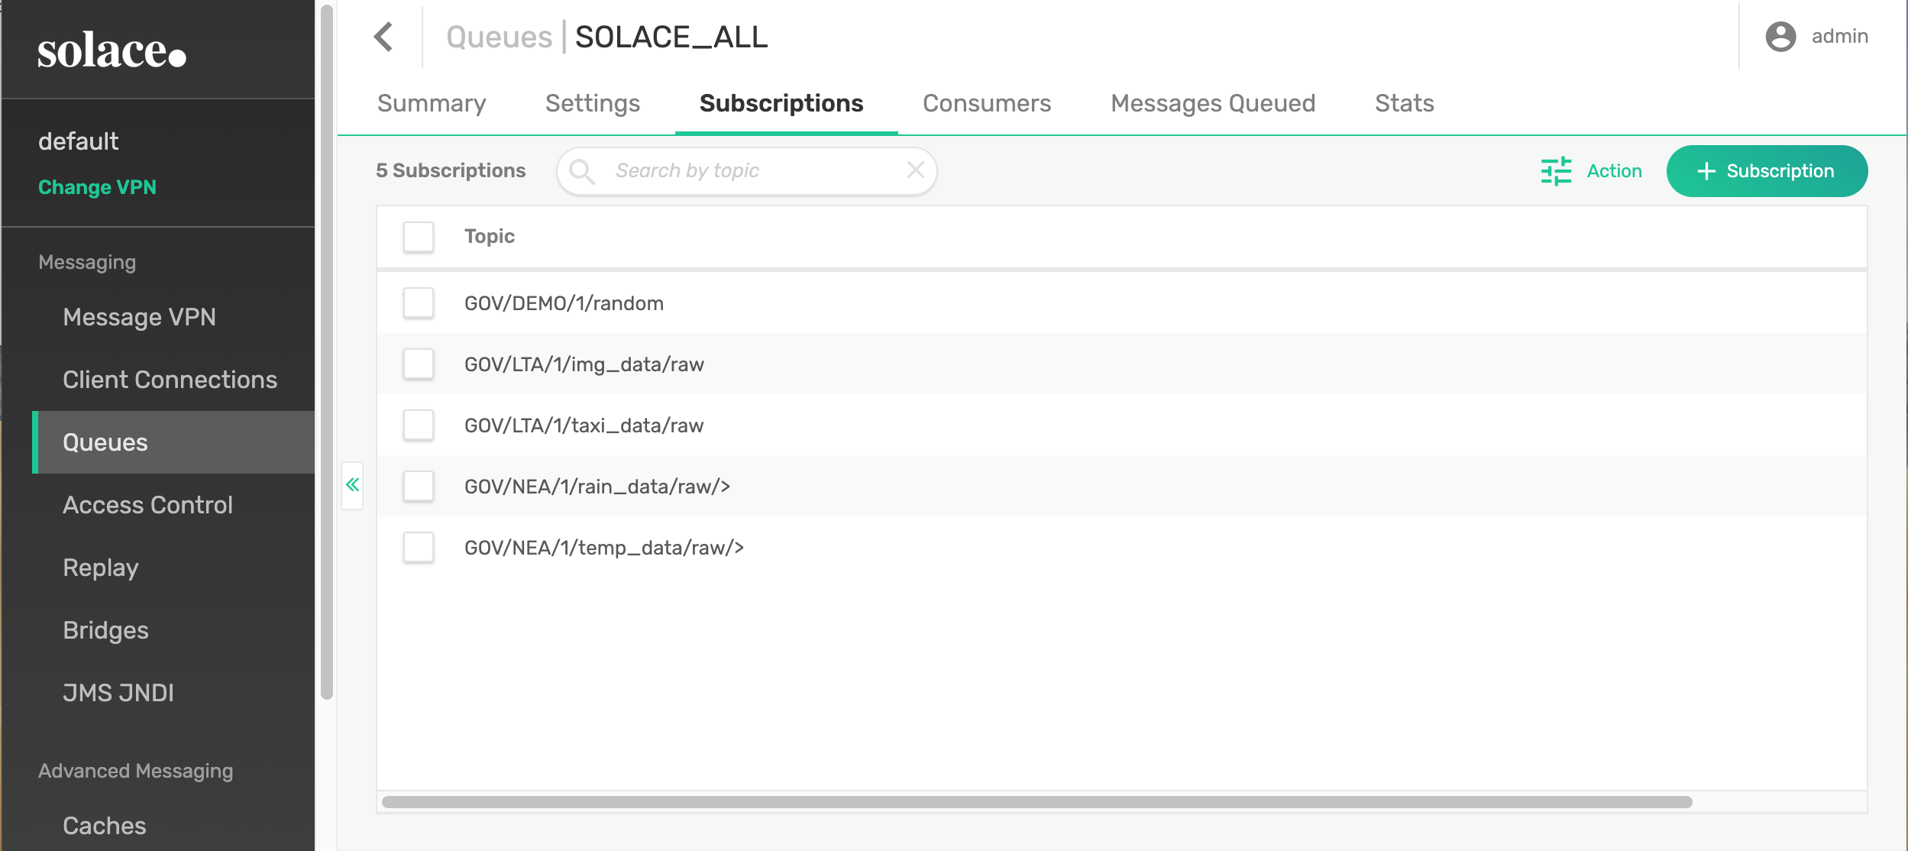
Data Source for Map Analytics (5. Queue)
The processing of the data flow diagram comes from a queue SOLACE_ALL consumption in central broker. Topics are shown in its subscription list.

Slide 35
Data Source for Map Analytics (6. Map Demonstration)
If configured correctly, all data being published from the console will be processed via central analytics and send to the map analytics.

